Slide 1




Generative Artificial Intelligence
Paul Dubois
Info@Lèze

Slide 2
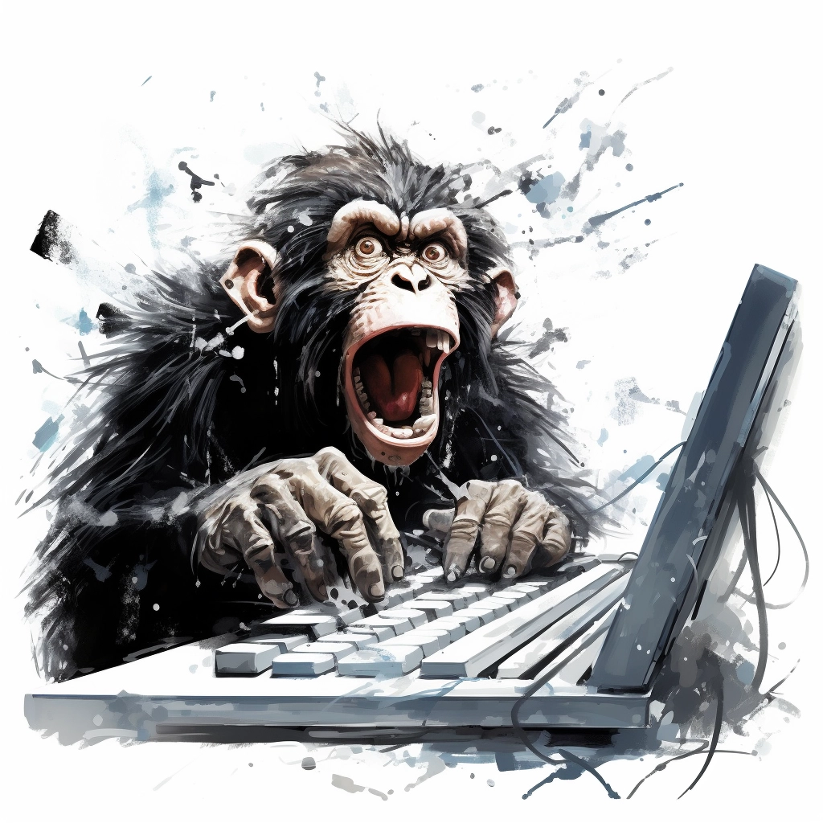
Creating new words

Slide 3
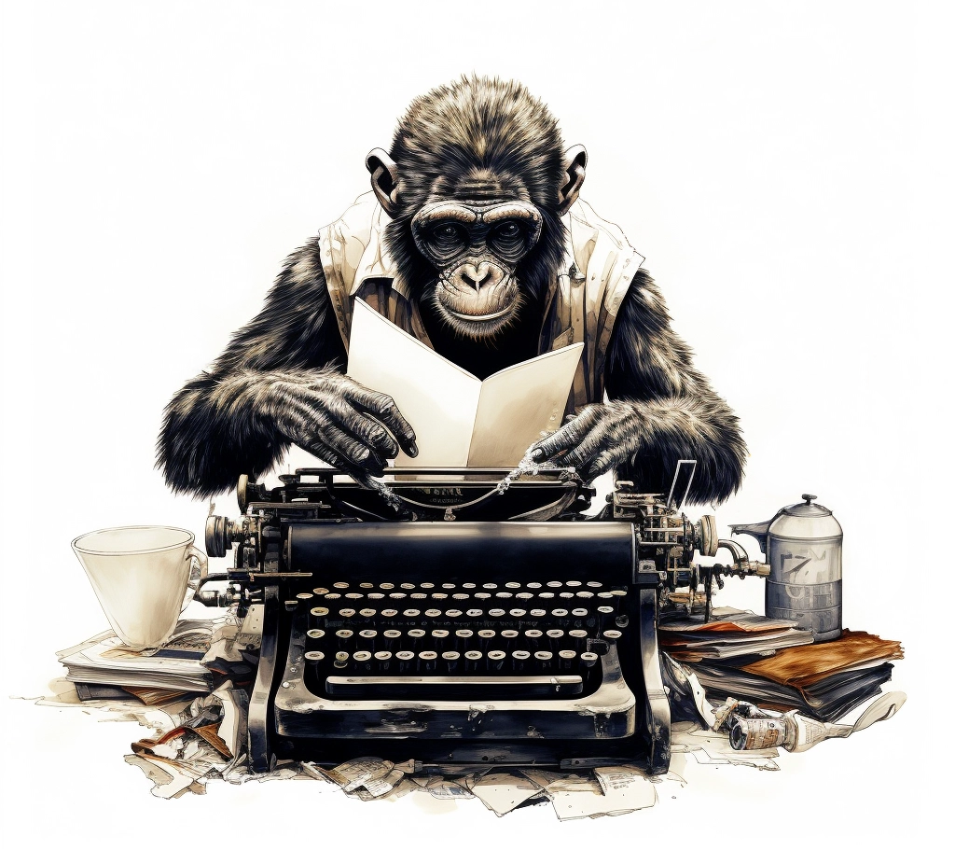
Method 1:
Randomly type on a keyboard

Slide 4
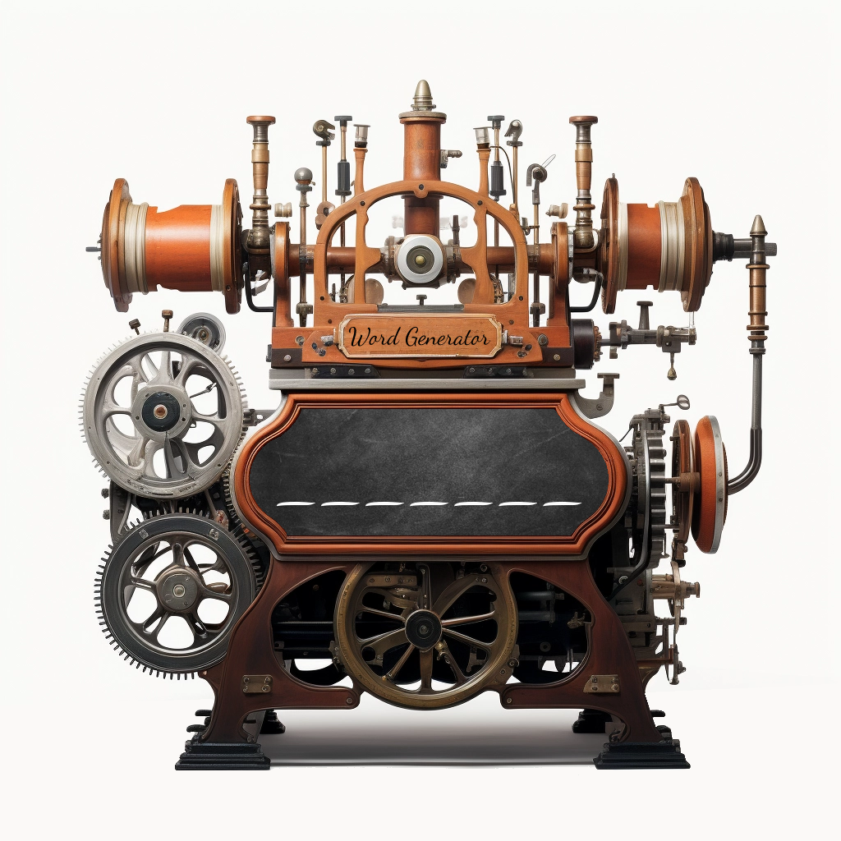
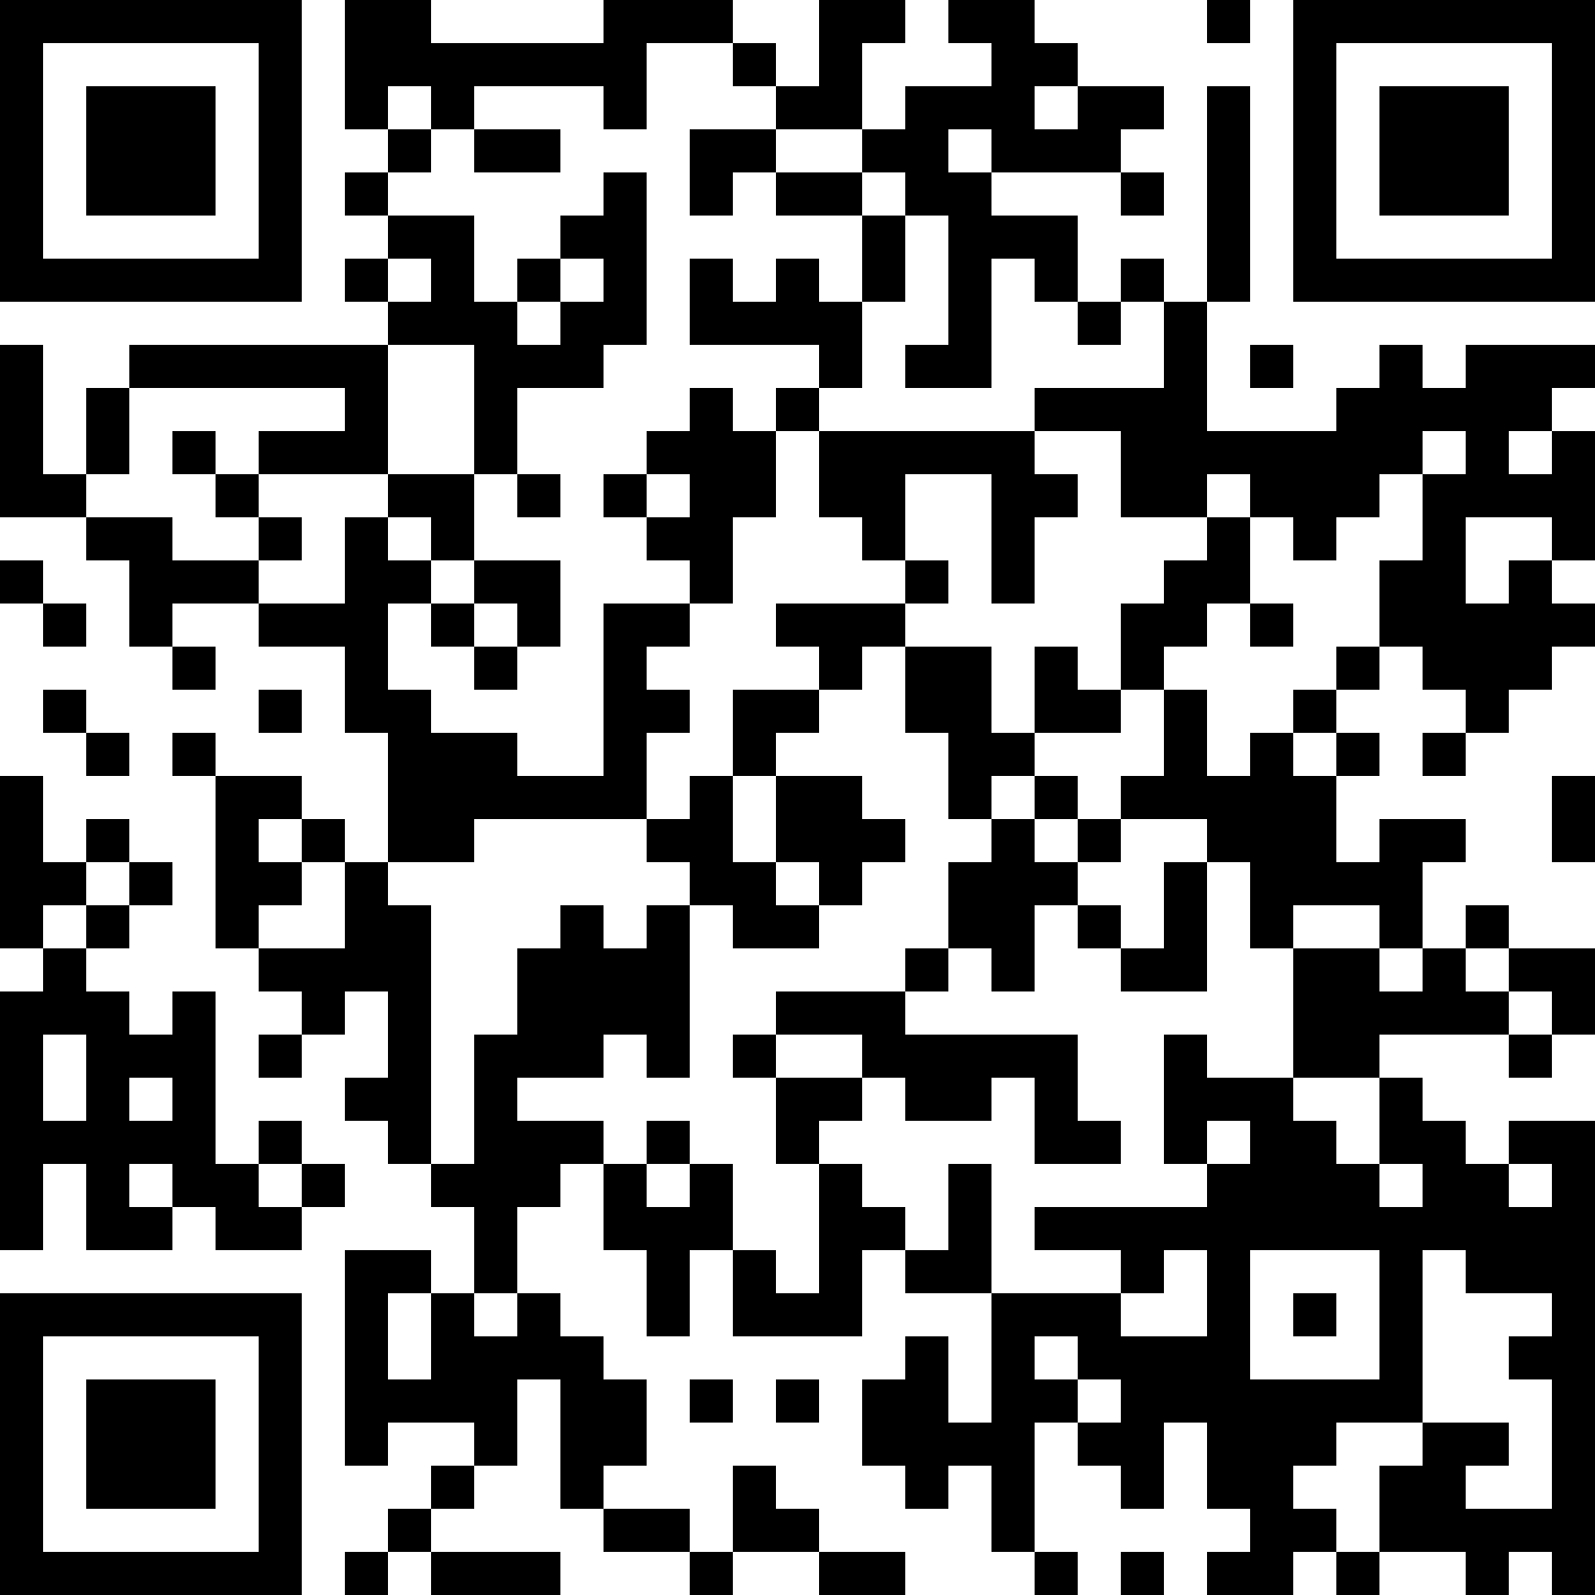
Words Generator Machine 1
https://pauldubois98.github.io/GenerativeAI/word_generator1.html

Slide 5
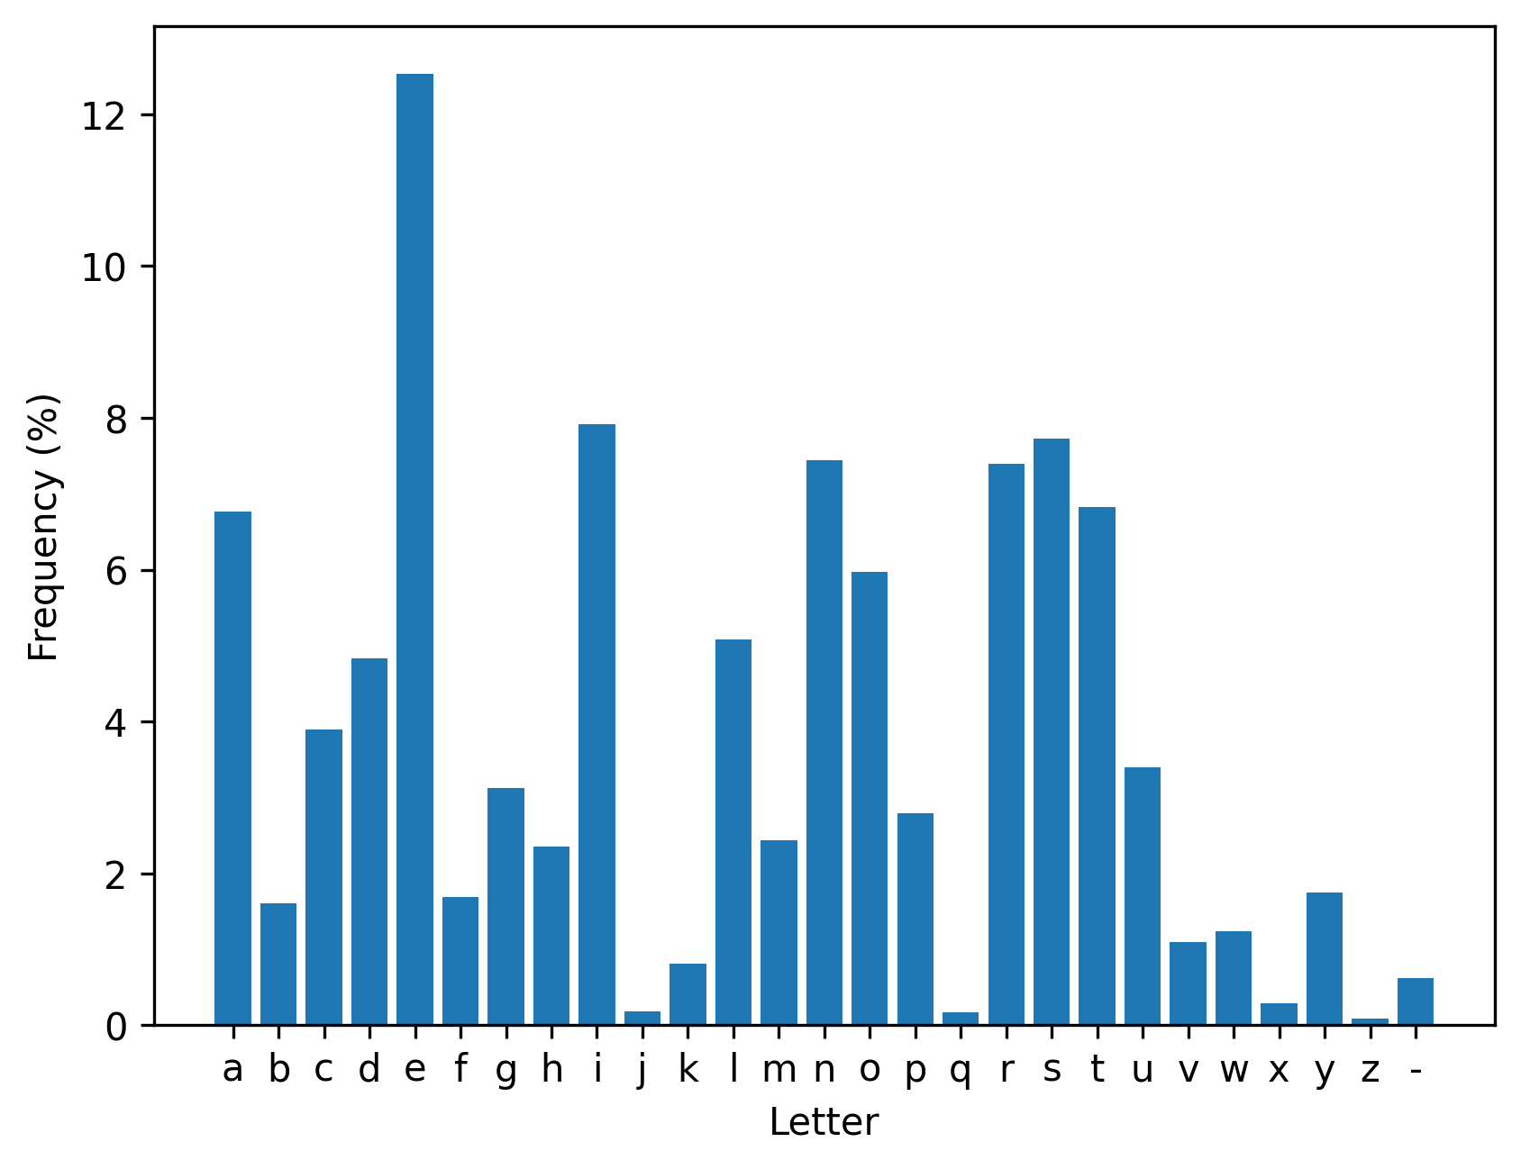
Letters usage (in dictionary)

Slide 6
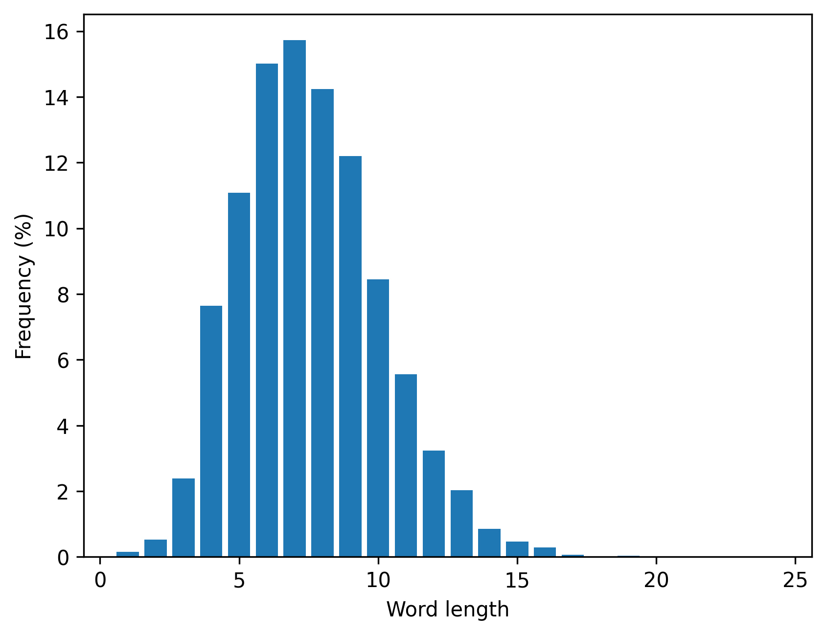
Words lengths (in dictionary)

Slide 7
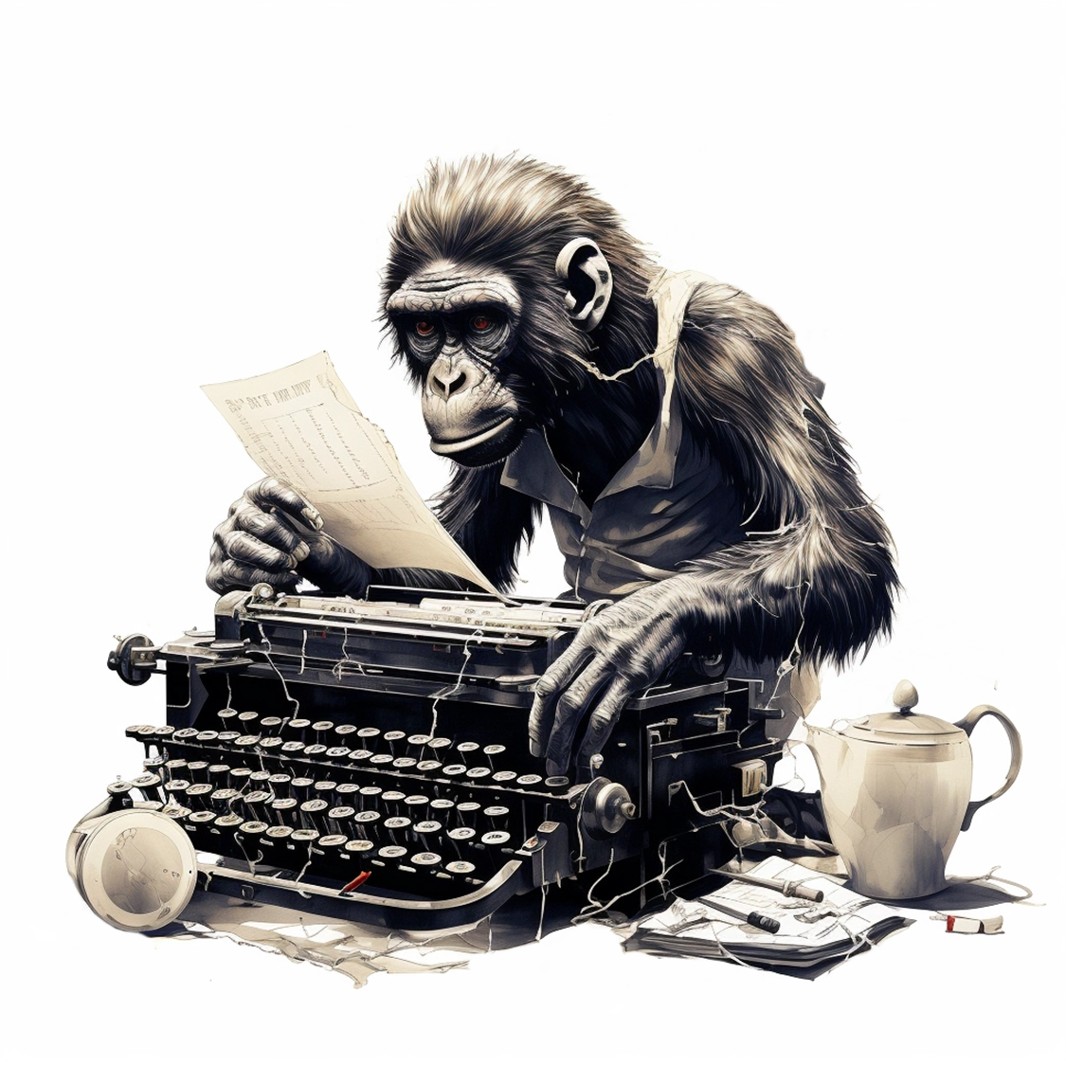
Method 2:
Type on a weighted keyboard

Slide 8
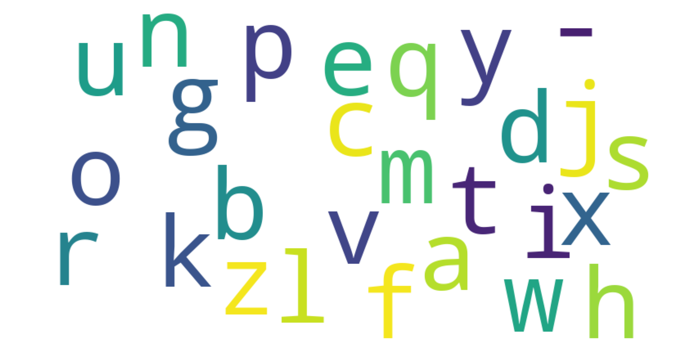
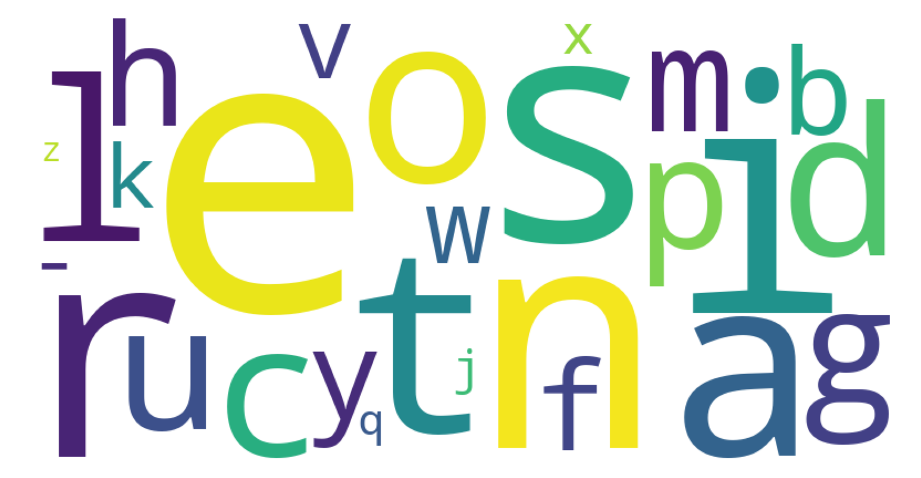
What is a “weighted” keyboard?
Non-weighted
Weighted

Slide 9
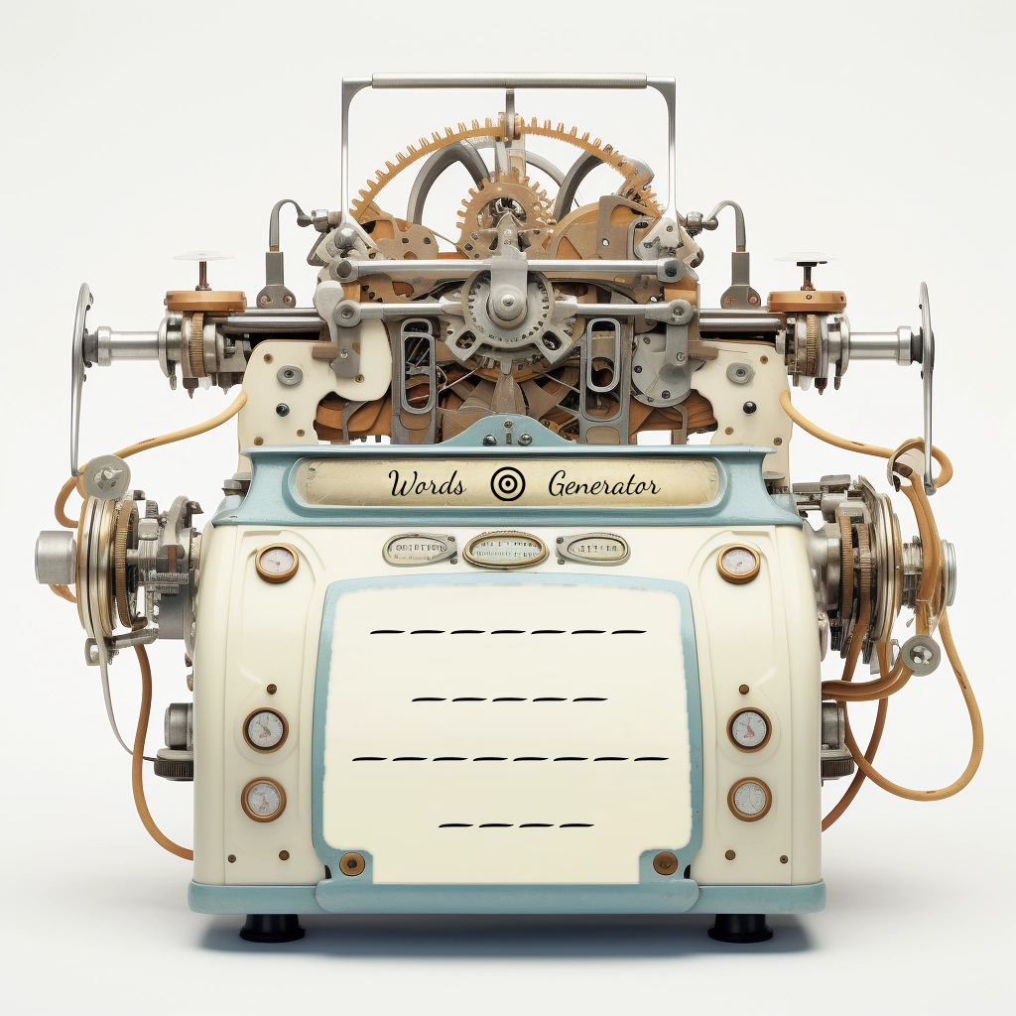
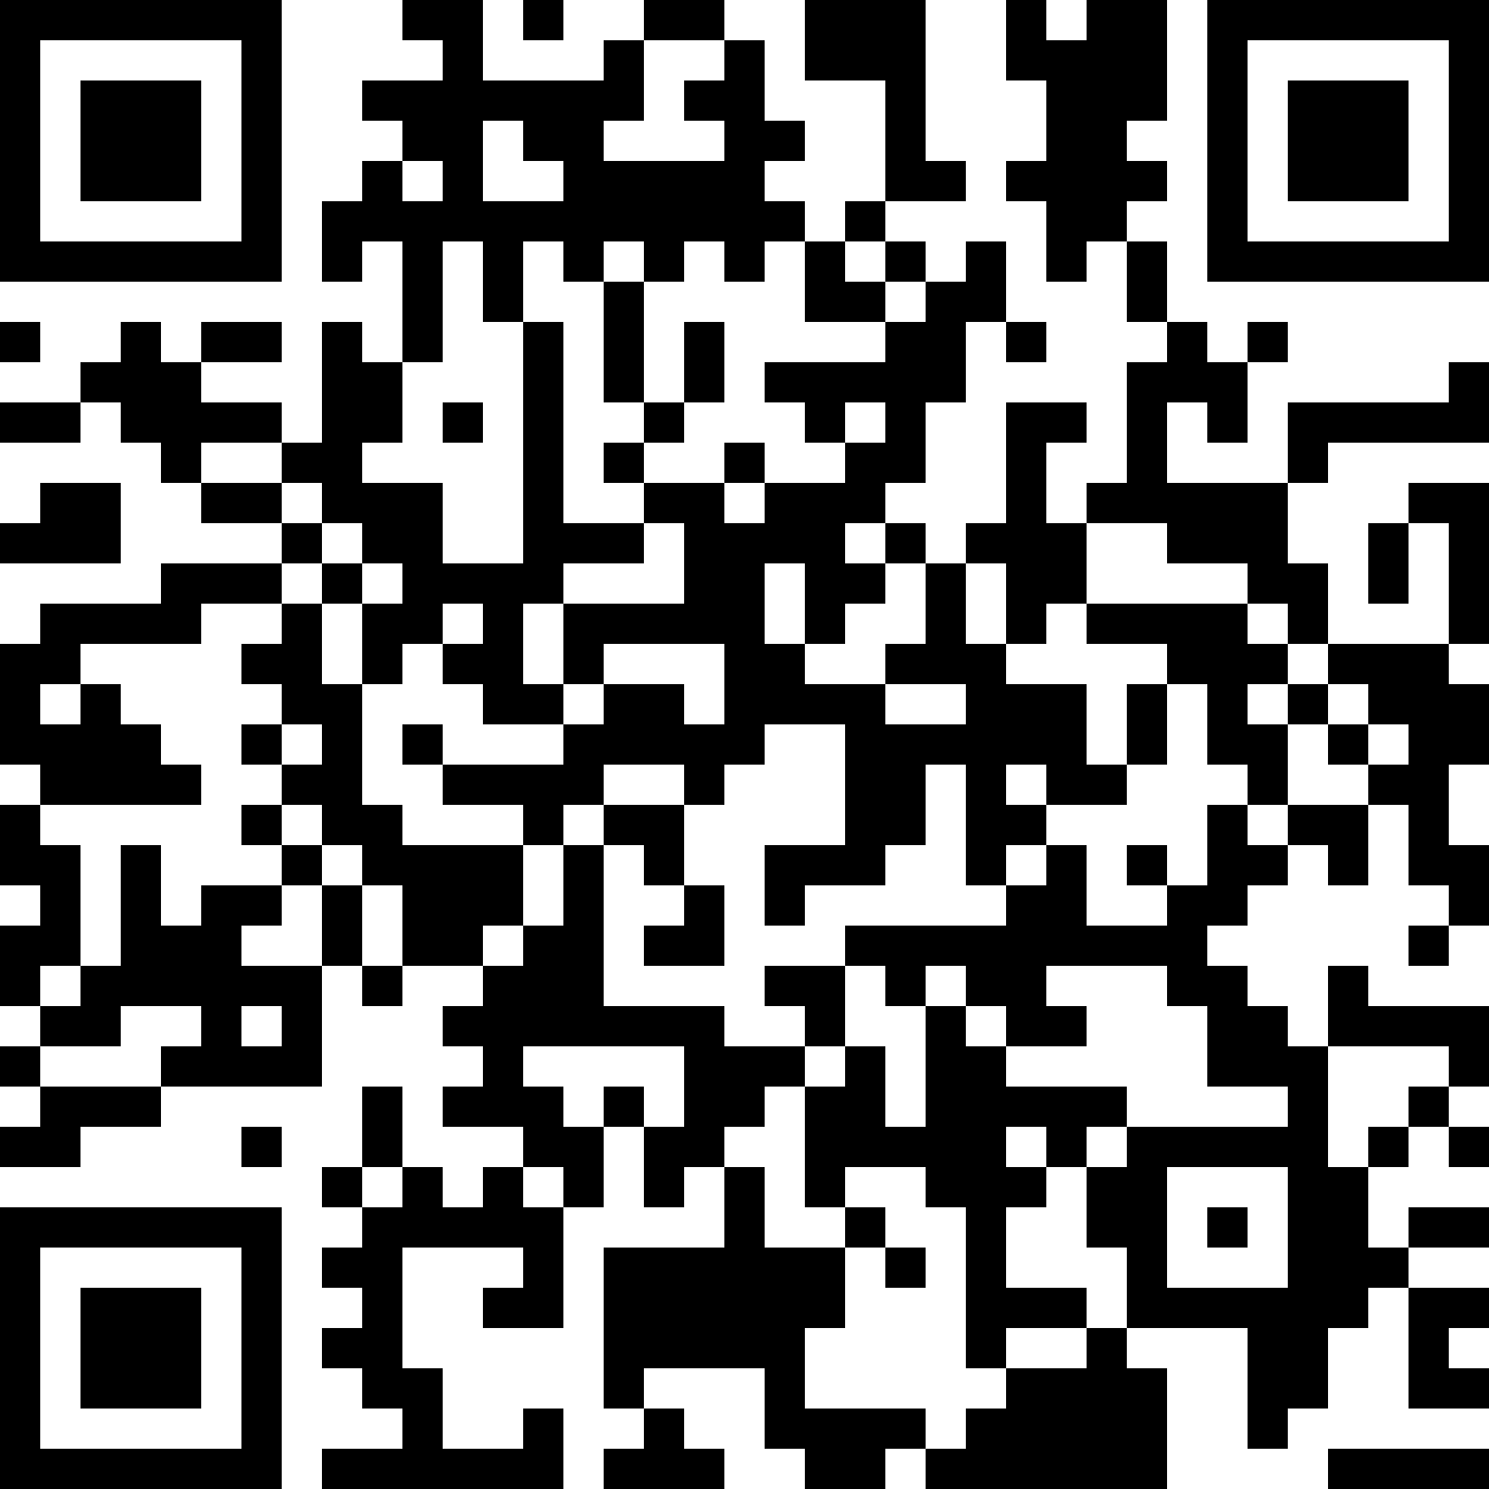
Words Generator Machine 2
https://pauldubois98.github.io/GenerativeAI/word_generator2.html

Slide 10
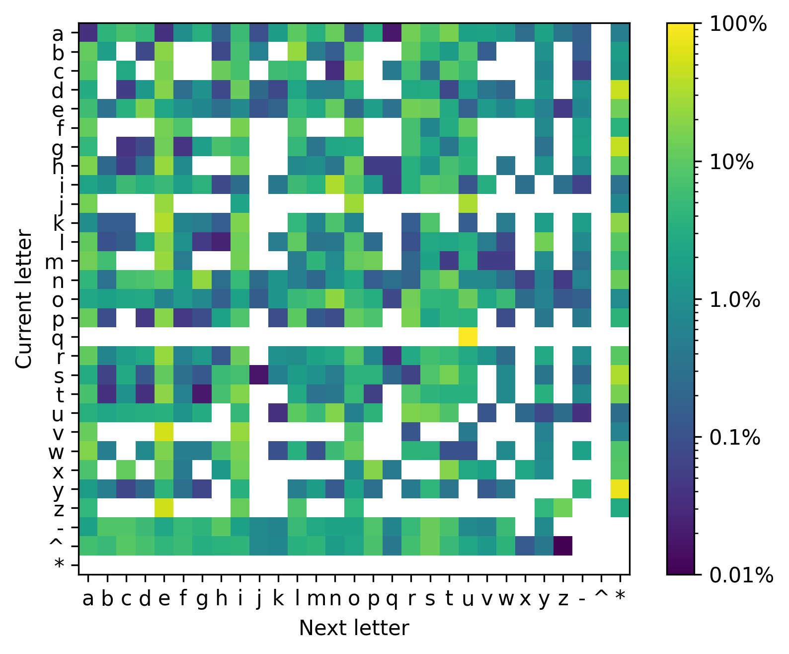
Markov Heatmap

Slide 11
Next Letter

Slide 12
Next Letter (2)

Slide 13
Next Letter (3)

Slide 14
Next Letter (4)

Slide 15
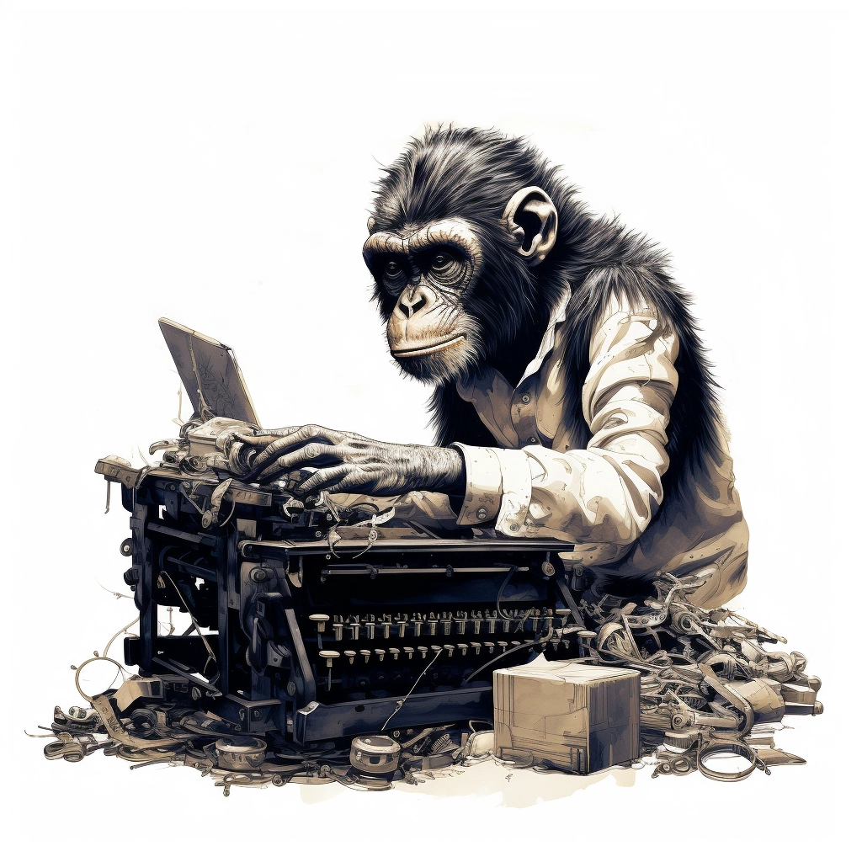
Method 3:
Dynamically weighted keyboard

Slide 16
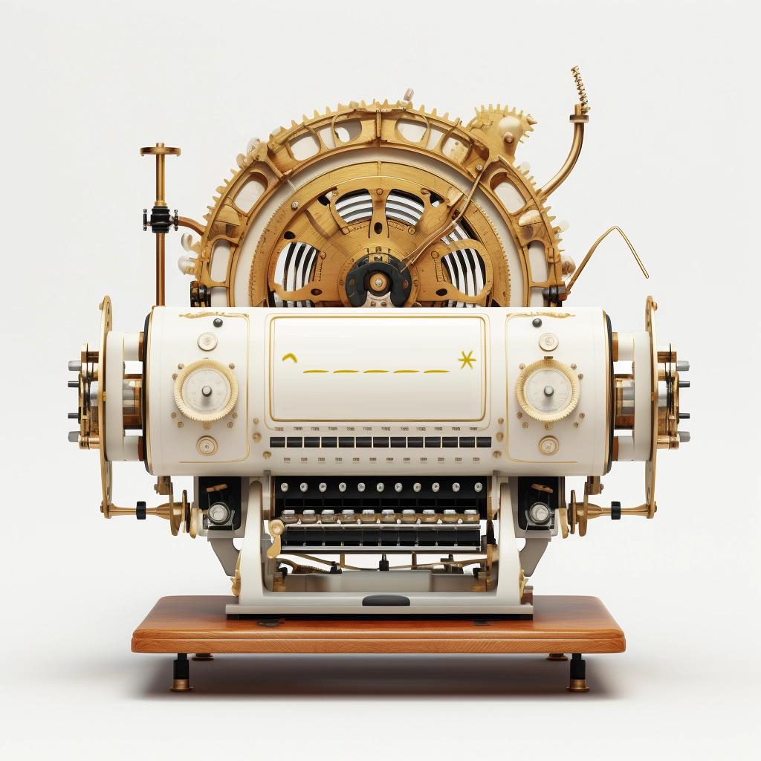
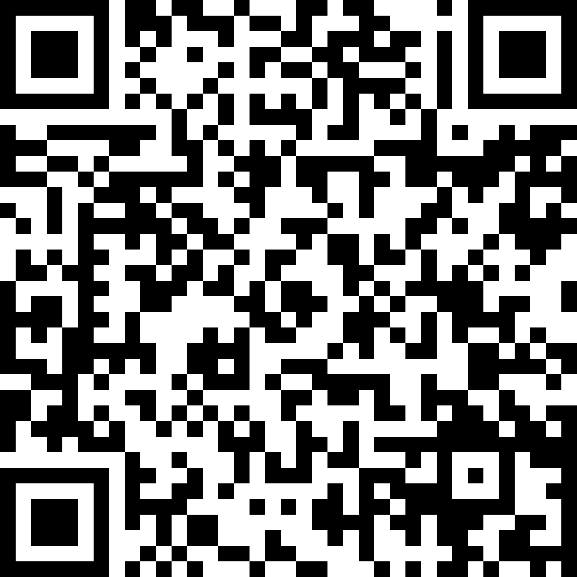
Words Generator Machine 3
https://pauldubois98.github.io/GenerativeAI/word_generator3.html

Slide 17
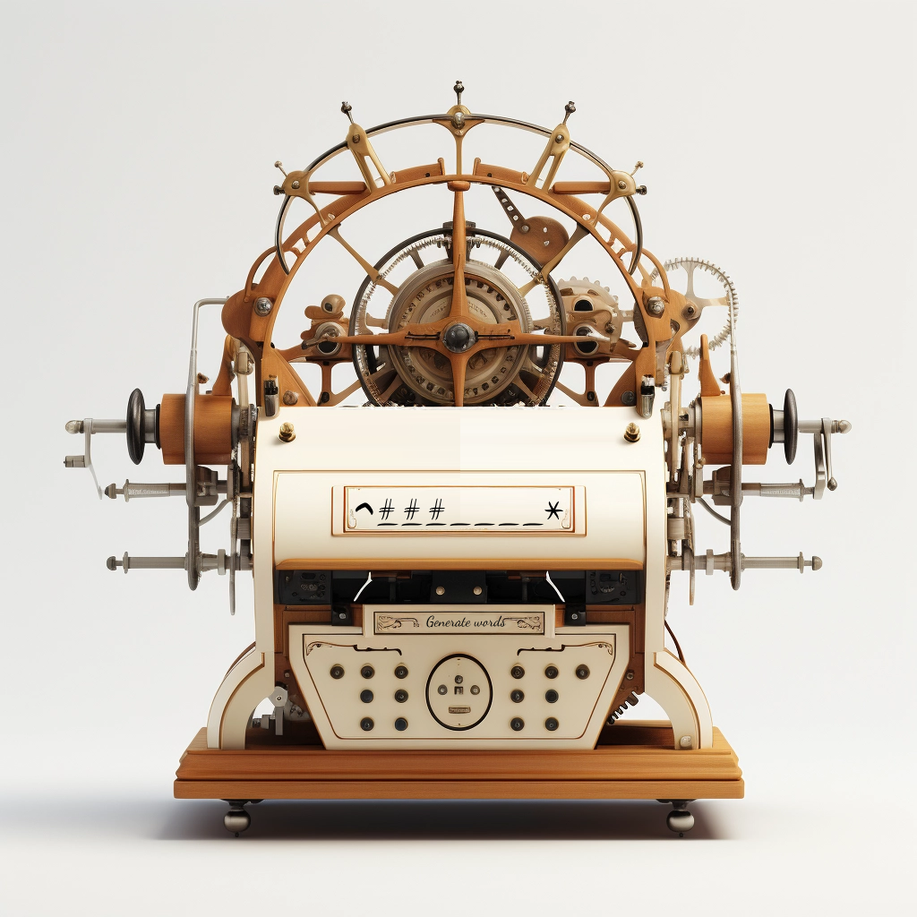
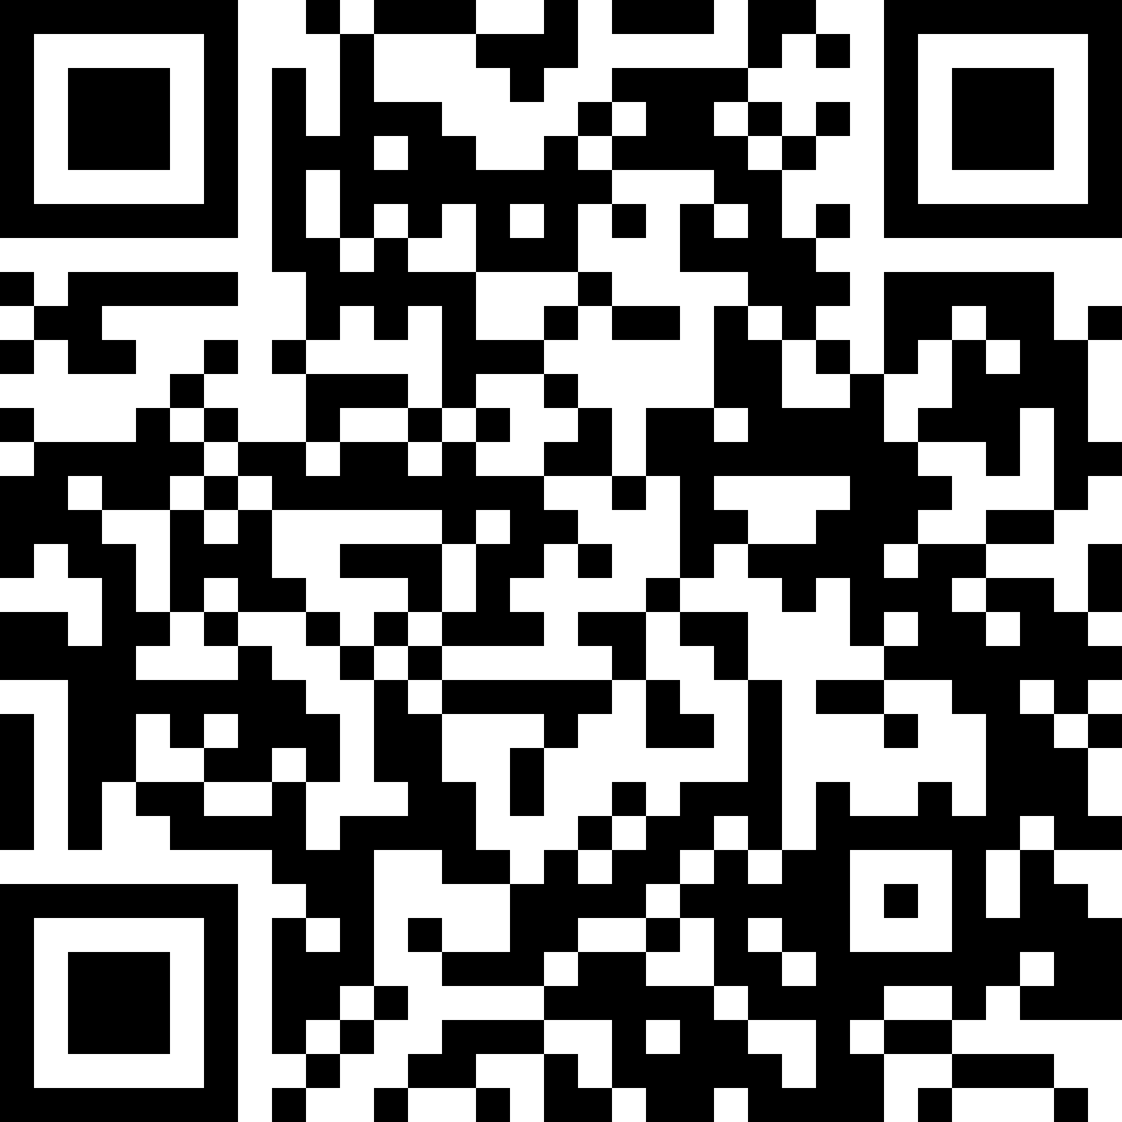
Custom Words Generator Machine 3 (bis)
https://pauldubois98.github.io/GenerativeAI/next_letters.html

Slide 18

Predict letters

Slide 19
Complete the word…
…with context
…h␣?
…e␣?
…m␣?
…a␣?
…t␣?
…i␣?
…c␣?
…s␣?
^math␣?
^mathe␣?
^mathem␣?
^mathema␣?
^mathemat␣?
^mathemati␣?
^mathematic␣?
^mathematics␣?

Slide 20
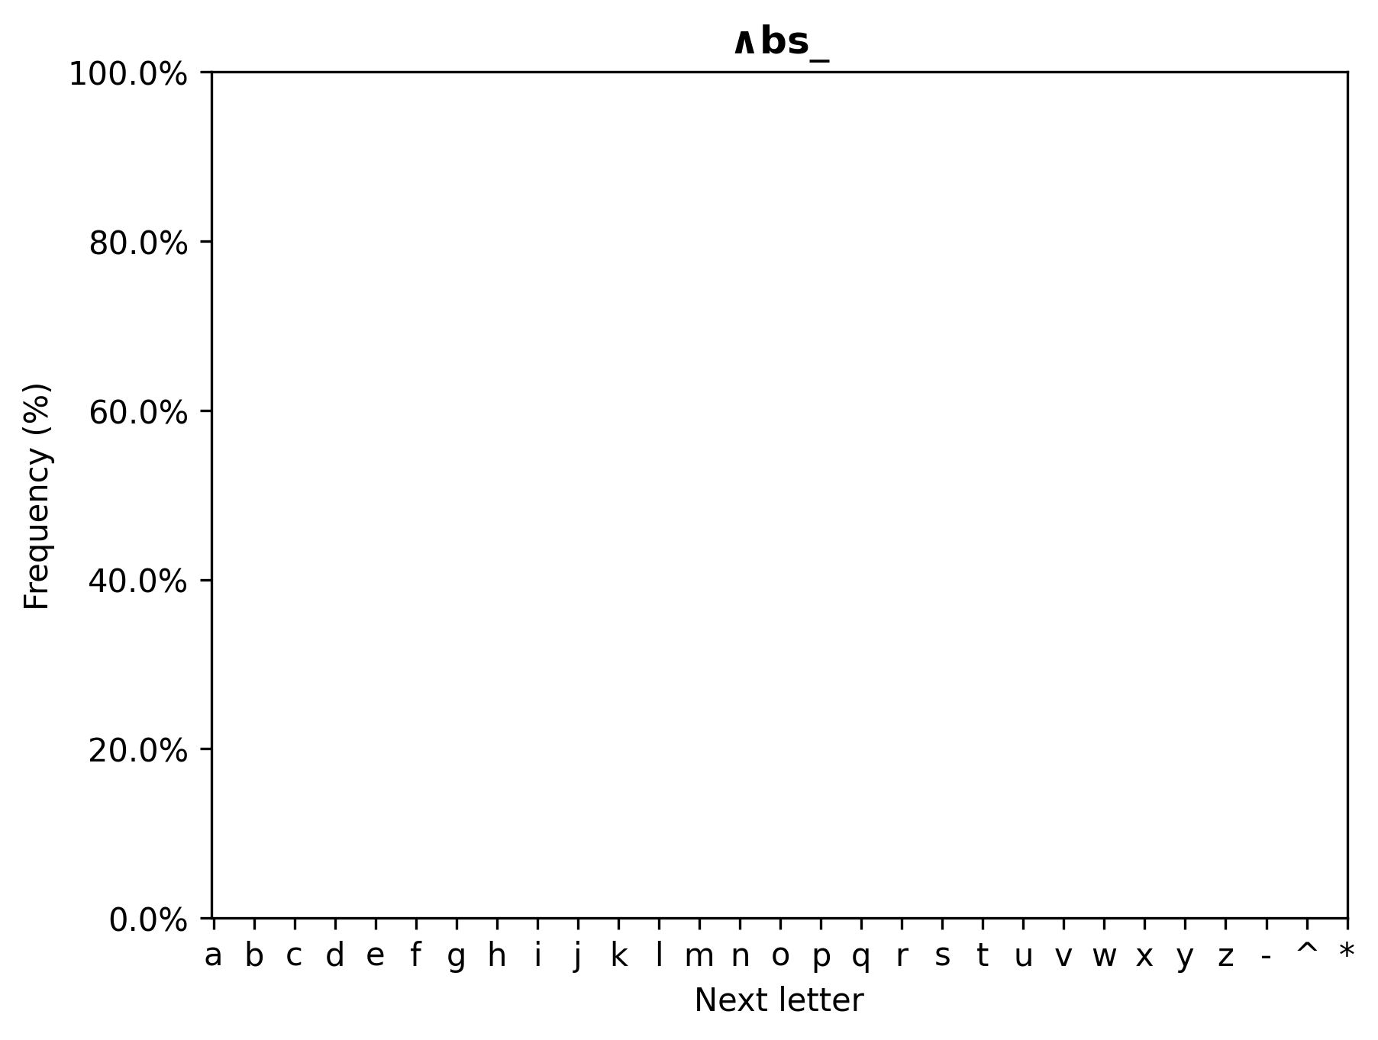
Dictionary search

Slide 21
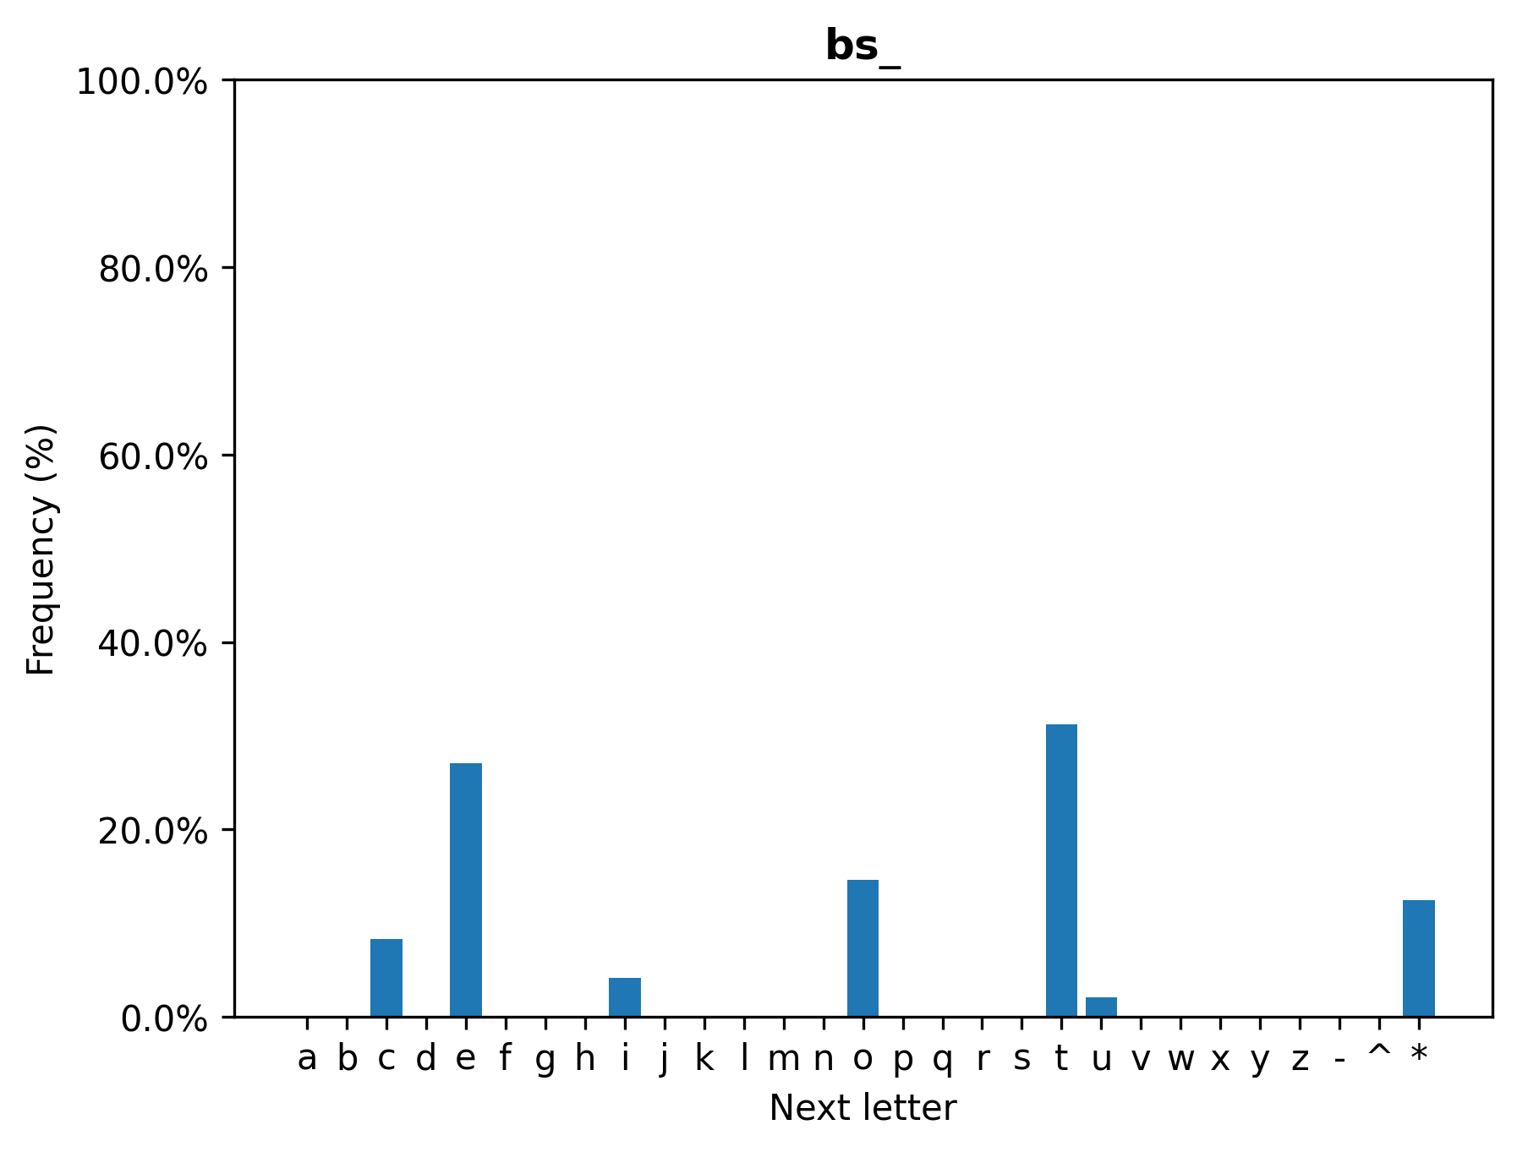
Dictionary search

Slide 22
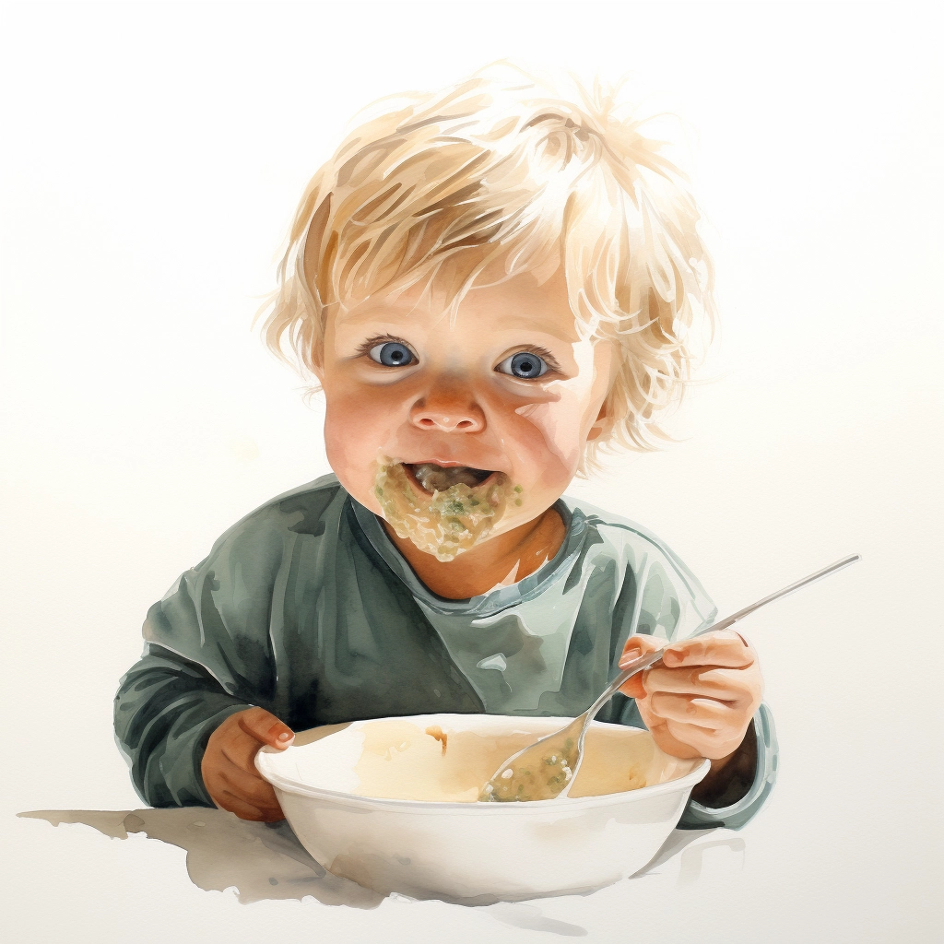
How do babies learn to eat purée?

Slide 23
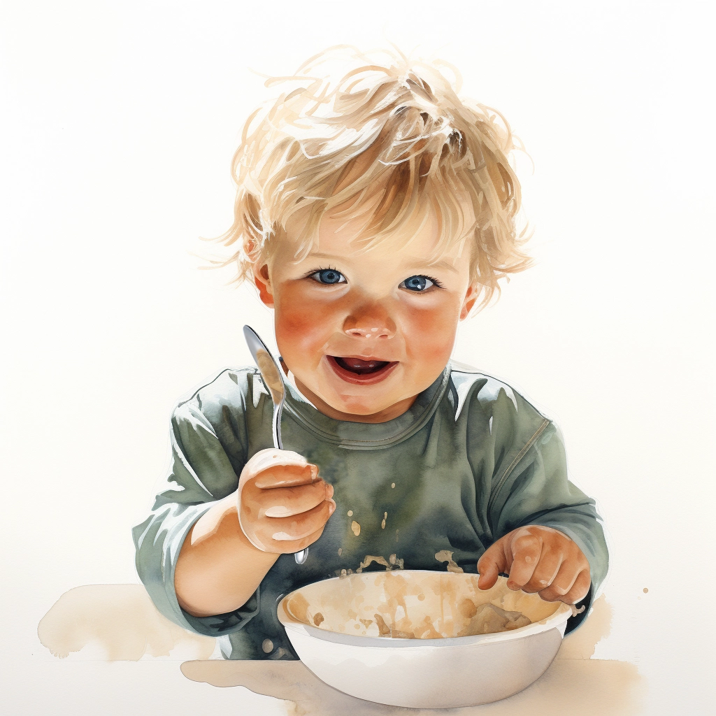
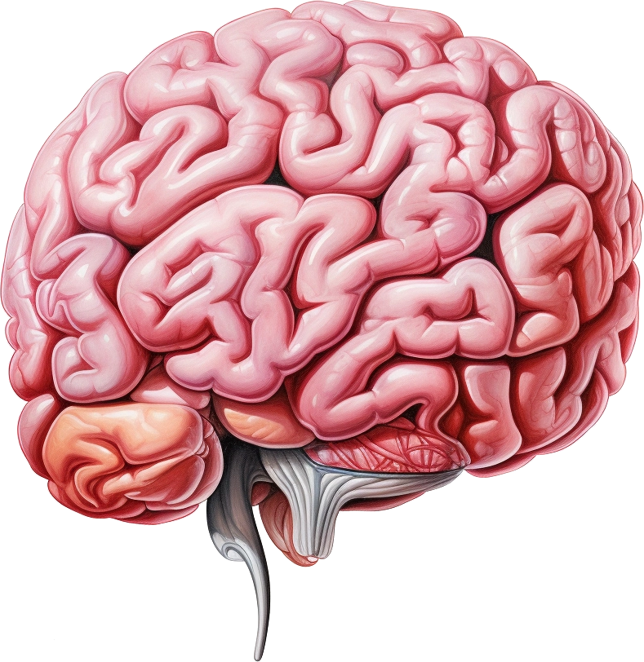

The brain

Slide 24
Generator vs Discriminator

Slide 25
Denoising

